Slide 1







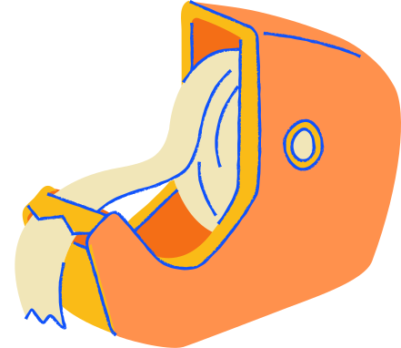
StressLess
Demo 2
Khanh Do, Nifemi Ogunmesa, Cheyanne Vinson, Madel Sibal, Alyssa Trapp, Tim Yu
Notes:
StressLess is a semester-long project for CSC-324, created by Khanh Do, Nifemi Ogunmesa, Cheyanne Vinson, Madel Sibal, Alyssa Trapp, and Tim Yu.

Slide 2
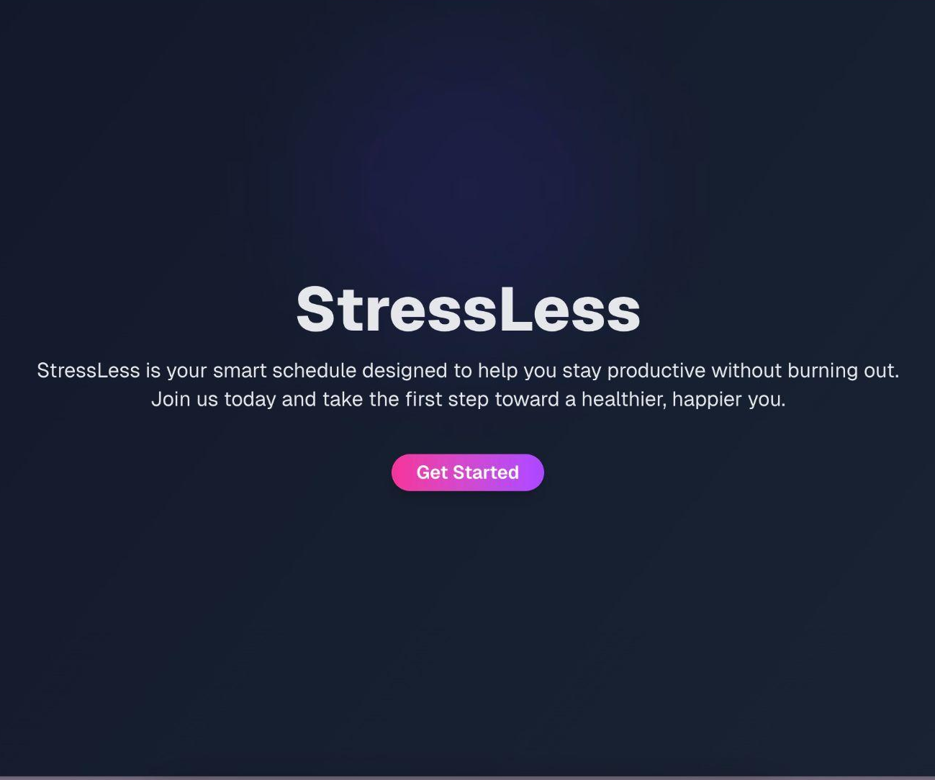
Our Product
A customized calendar tailored to your productivity preferences, break times, and scheduled events
Creates a calendar for an individual based on their survey answers and event plans
Notes:
Description of StressLess:
StressLess is a smart schedule tailored to an individual’s productivity preferences. The user can input their schedule and answer a preference survey, and StressLess will customize the best possible schedule for them based on their input.

Slide 3





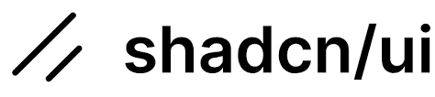


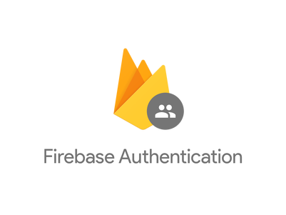



StressLess Software Architecture
User Interface (Frontend)
Business Logic (Backend)
Database
Public route
Protected route
API calls
Collects User Preferences endpoint
USER
Sign Up
Profile View
Write
(Create
Update
Delete)
Add/Update/Delete User Events endpoint
Sign In
Calendar View
Responses
Add/Update/Delete User Deadlines endpoint
Users
Validate token
Preferences
BROWSER
Generate Schedule endpoint
Questions
Read
Events
Issues uid token
Deadlines
Authentication & Authorization
(by third party)
Notes:
Implemented:
Frontend:
Authentication service
Sign up
Sign in
Sign out
Backend:
CRUD operations for auth
CRUD operations for events
CRUD operations for deadlines
CRUD operations for preferences
Database:
Writing and reading database (via Prisma)
Database schema implemented

Slide 4
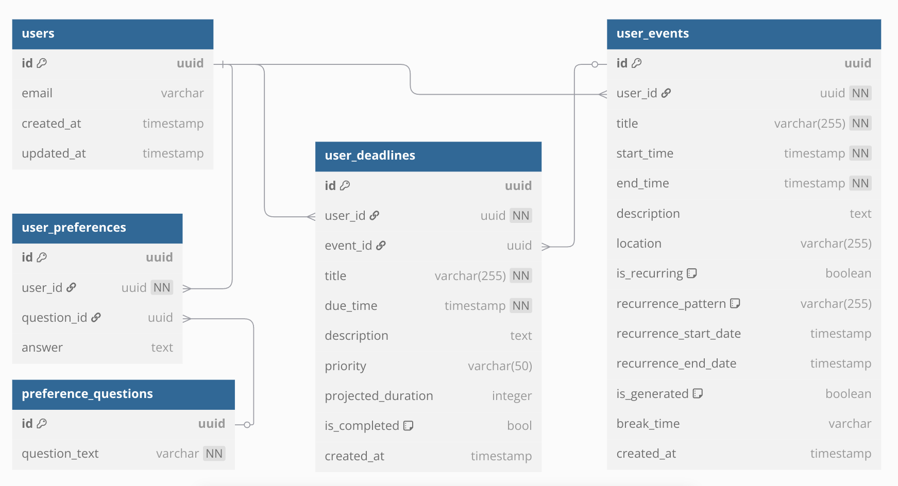
Notes:
All the tables are created already in accordance to the schema.
We use Prisma to create tables from the schema.
The database uses PostgreSQL hosted by Neon.

Slide 5

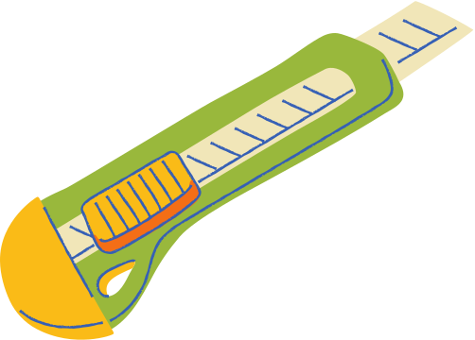


Demo and
Code Explanation
Notes:
We will first show the new updates in our frontend, which is integrated with real API call to our backend. We also wrote unit tests for our backend API endpoints. We will also showed our Continuous Deployment pipeline.

Slide 6
New Features
Notes:
We will explain and demonstrate the new features we implemented.

Slide 7
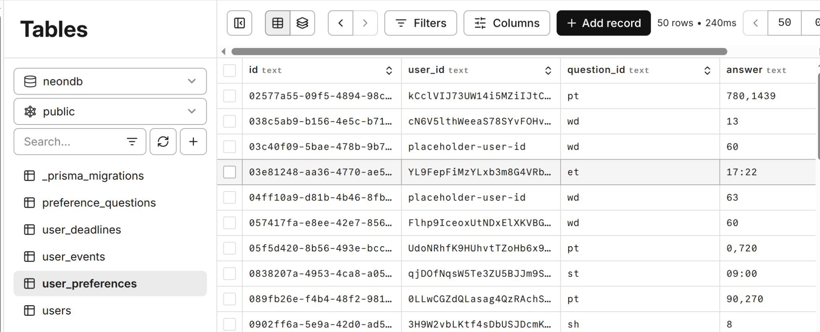
User Preferences
User’s preferences answers are shown on Profile Page. Before, it uses default values. Now, it fetches the data from the backend to show on the frontend.
When an user edit their preferences and save their new preferences, the database is updated with the new answers. When the users come back to their Profile Page, that new information replaced the old one.
Notes:
User’s preferences answers are shown on Profile Page. Before, it uses default values. Now, it fetches the data from the backend to show on the frontend.
When an user edit their preferences and save their new preferences, the database is updated with the new answers. When the users come back to their Profile Page, that new information replaced the old one.

Slide 8
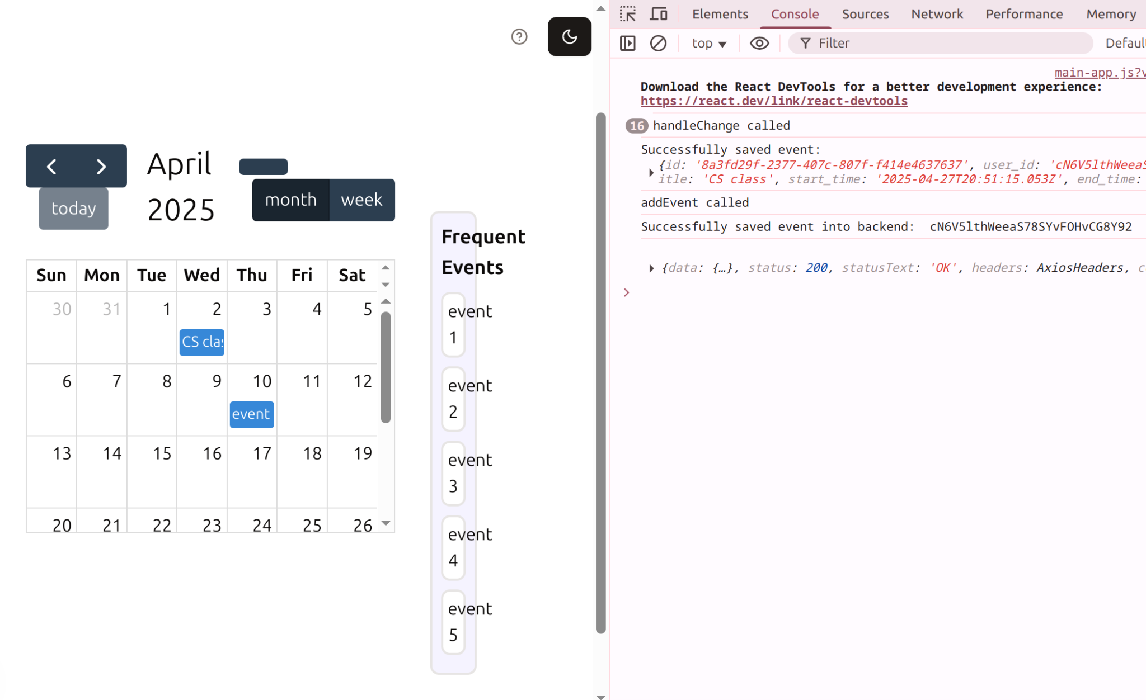
Adding Events
When an user add an event (either by dragging or submitting a form), that event is added to the database.
Notes:
User’s preferences answers are shown on Profile Page. Before, it uses default values. Now, it fetches the data from the backend to show on the frontend.
When an user edit their preferences and save their new preferences, the database is updated with the new answers. When the users come back to their Profile Page, that new information replaced the old one.

Slide 9
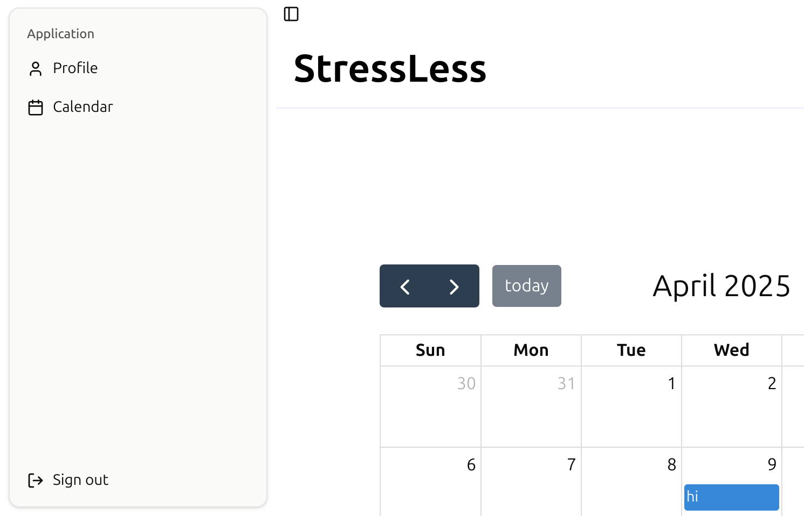
Sidebar
There is now a side-bar (or called hamburger menu) that centralizes all routes that we have: Calendar, Profile Page. Upon signed-in, user is routed to /dashboard where they can click on the side-bar button to show navigations to other places of the app.
Notes:
There is now a side-bar (or called hamburger menu) that centralizes all routes that we have: Calendar, Profile Page. Upon signed-in, user is routed to /dashboard where they can click on the side-bar button to show navigations to other places of the app.

Slide 10
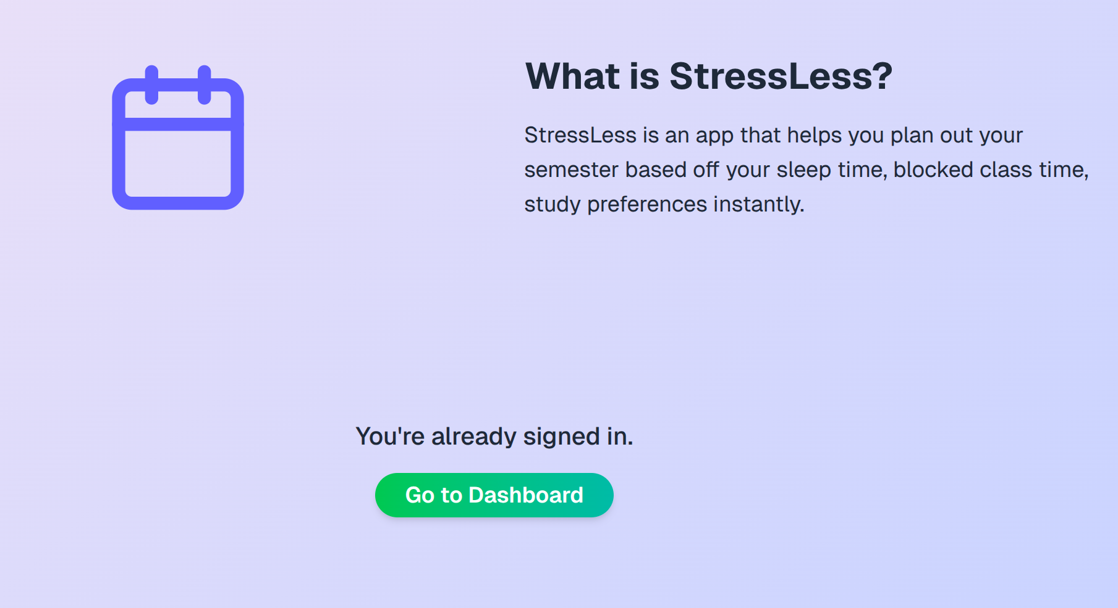
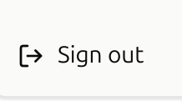
Logout & Protected Routes
There is now a Log out button that log the user out.
If the user is not signed-in (or not authenticated), they can only route to / . Meaning if they try to go to /dashboard, they will be automatically redirected.
If the user is signed-in (or is authenticated), they will not see the Sign up, Sign in form on the landing page /, but they will have the option to click on a button that says Go to dashboard.
Notes:
There is now a Log out button that log the user out.
If the user is not signed-in (or not authenticated), they can only route to / . Meaning if they try to go to /dashboard, they will be automatically redirected.
If the user is signed-in (or is authenticated), they will not see the Sign up, Sign in form on the landing page /, but they will have the option to click on a button that says Go to dashboard.

Slide 11
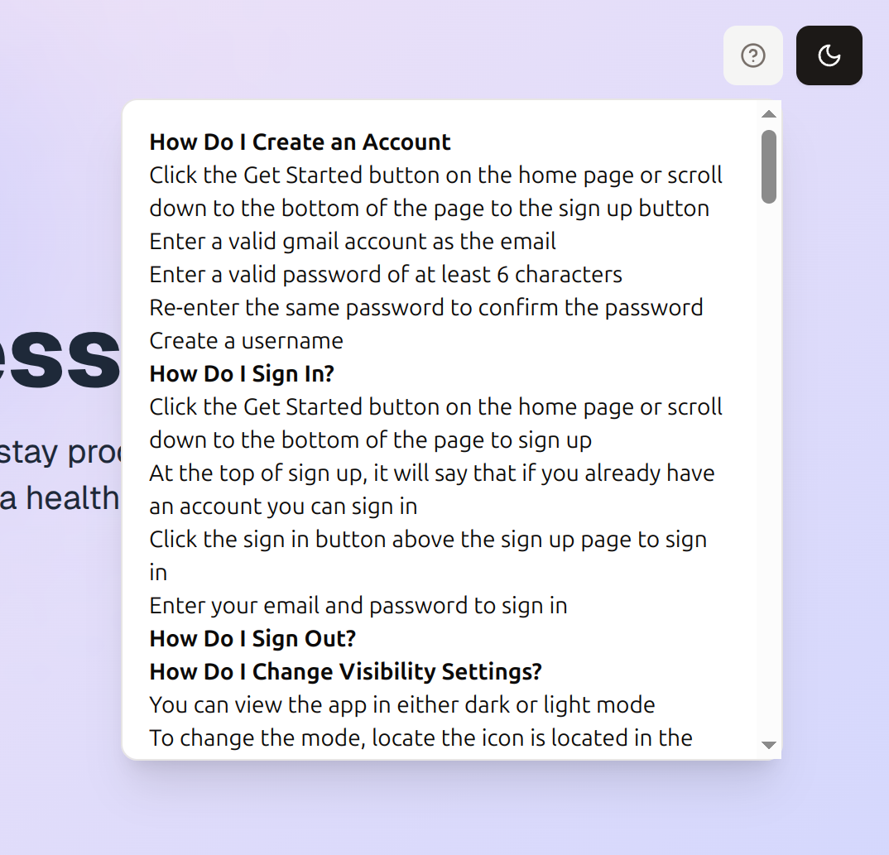

Help Button
There is now a Help button on the top right corner of the app. Upon clicking, a pop-up will appear that says how to use the app in detailed.
Notes:
There is now a Help button on the top right corner of the app. Upon clicking, a pop-up will appear that says how to use the app in detailed.

Slide 12
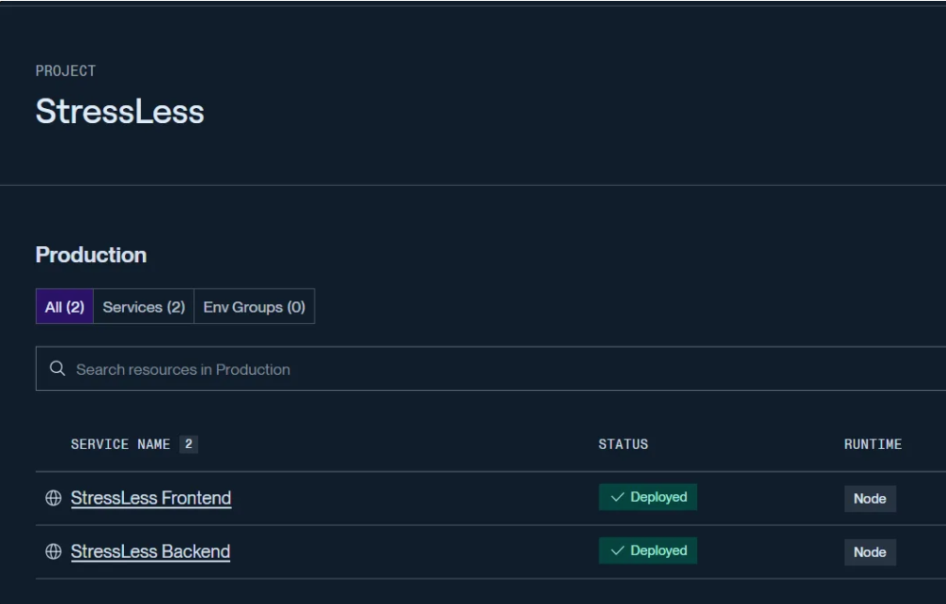
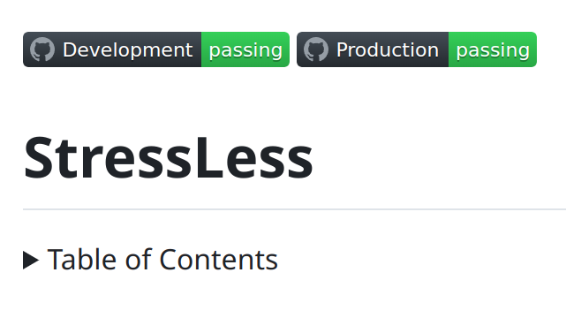
Continuous Deployment
All commits to the main branch automatically trigger re-deployment via GitHub Actions.
Both frontend and backend are hosted on Render, ensuring live updates with every merge.
Notes:
All commits to the main branch automatically trigger re-deployment via GitHub Actions.
Both frontend and backend are hosted on Render, ensuring live updates with every merge.

Slide 13
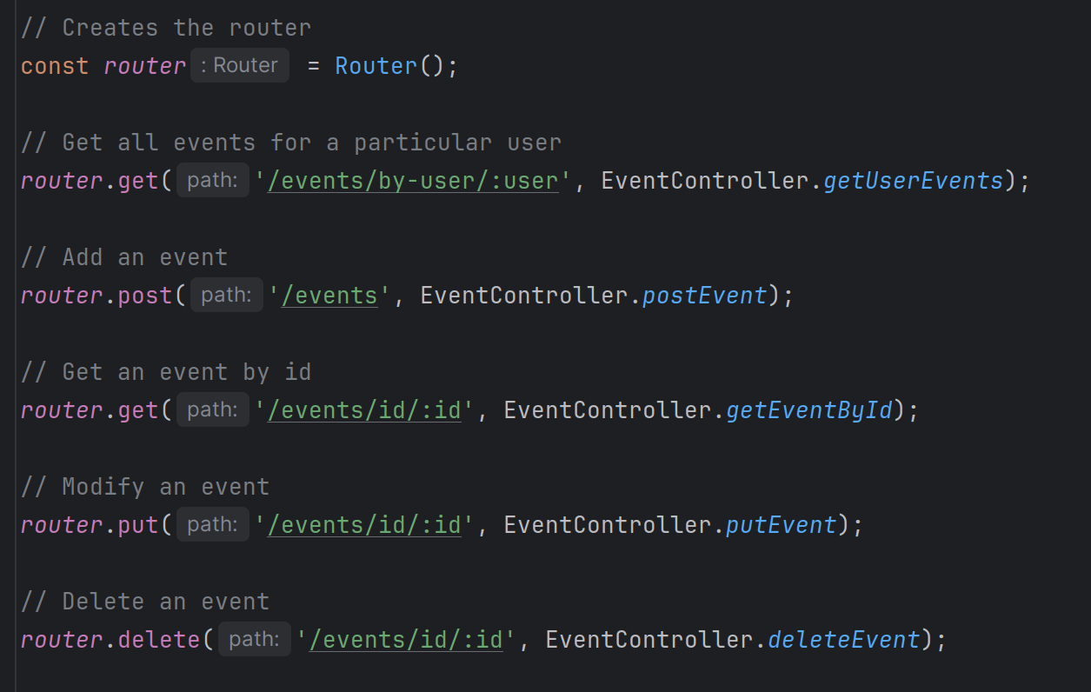
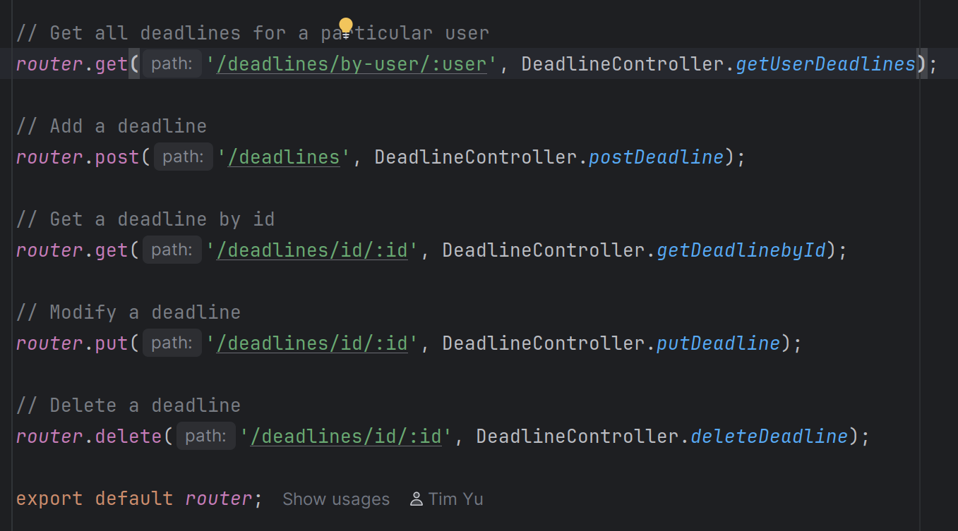
Backend: Events & Deadlines
API Endpoints Create-Read-Update-Delete (CRUD) operation for events and deadlines, ready to be integrated end-to-end.
Notes:
API Endpoints Create-Read-Update-Delete (CRUD) operation for events and deadlines, ready to be integrated end-to-end.

Slide 14
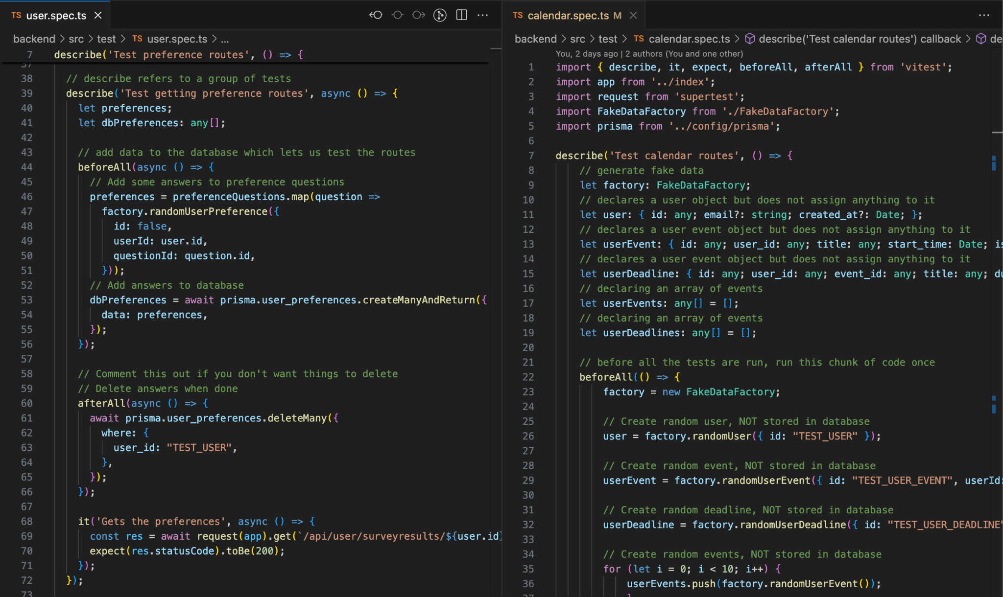
Backend Unit Test
Notes:
Note: Screenshots on the slide are for reference only. Code will be demonstrated live during the presentation.
The left side shows a test for one of the user routes, which illustrates a user preference being retrieved from the database
To test the route, we first declare an array of user preferences, which we then populate with fake data and lastly push to the database
Then, we retrieve the user preference by its ID to check if the get route worked
Lastly (not shown in the screenshot), we delete our data from the database following a successful test
The right side shows the starter code for our calendar tests, which shows all the declarations for our calendar tests, later populated with fake IDs following their declarations

Slide 15
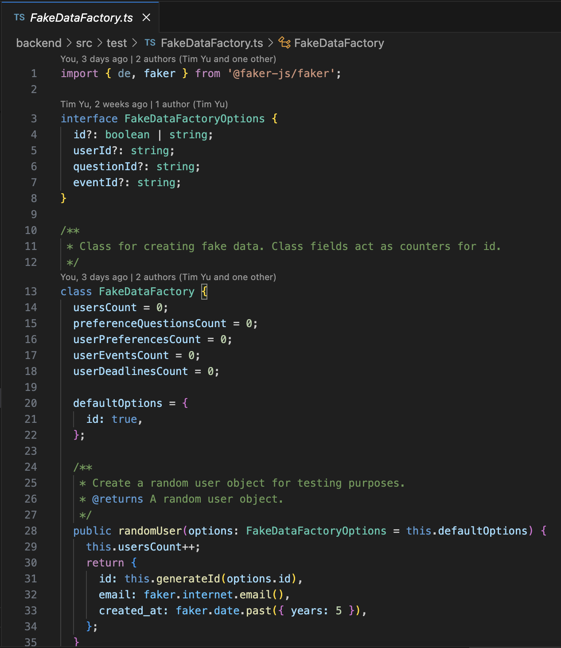
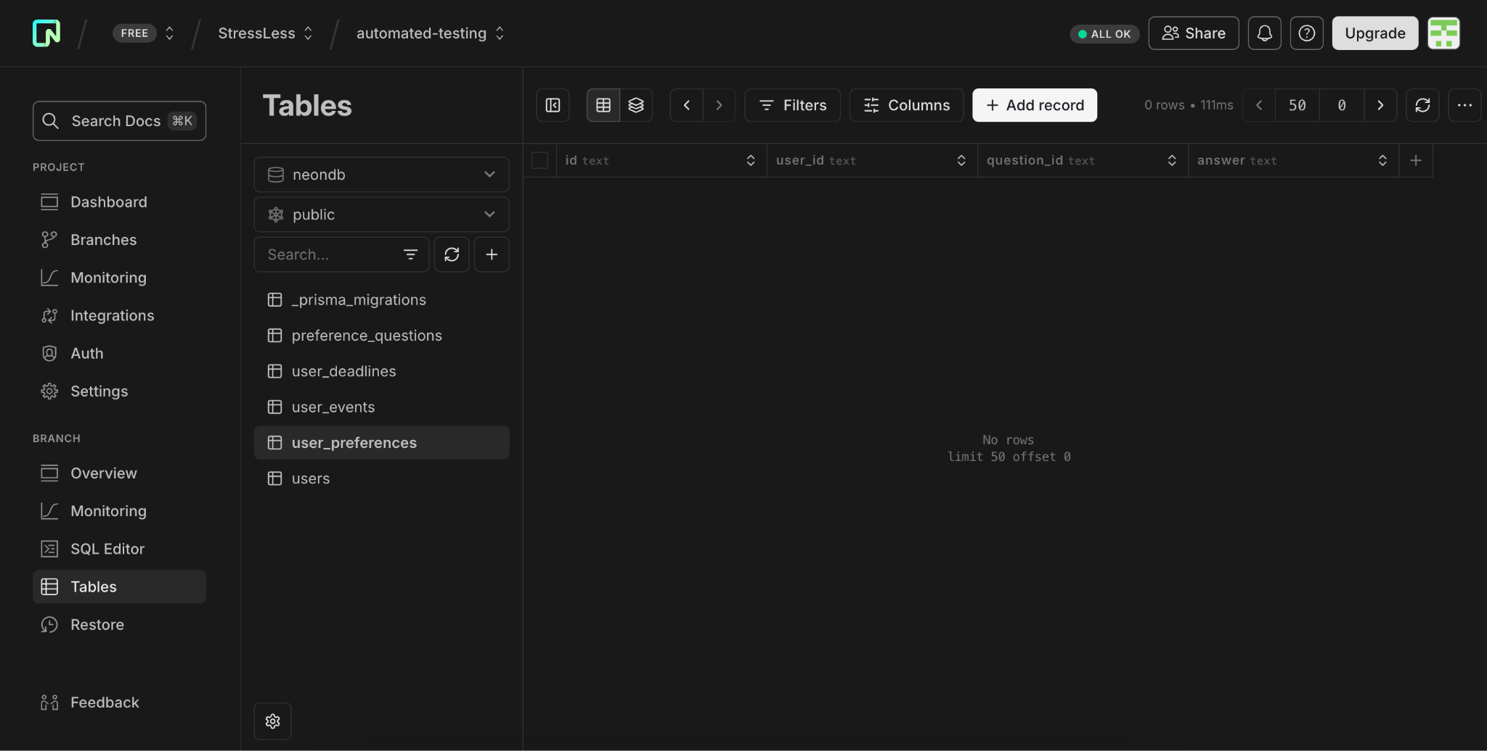
Backend Unit Test
Notes:
Note: Screenshots on the slide are for reference only. Code and database will be demonstrated live during the presentation.
To test if the data is being stored in our database, we set up and utilized a fake data factory to populate the columns of each of our data models.
The left side shows the code for the set up of the fake data factory.
Due to usage constraints on Neon database, we had to create a separate testing branch in our database for automated testing purposes only. This is so that we could ensure that we do not exceed the usage limits of our database and render the database unusable.
The right side shows the Neon database interface, and the top left corner shows the branches in our database.

Slide 16



Q & A
Notes:
Ask the class if they have any questions

